Slide 1
RUNGTA COLLEGE OF DENTAL SCIENCES & RESEARCH
DISASTER MANAGEMENT (PART-1)
DEPARTMENT OF PUBLIC HEALTH DENTISTRY

Slide 2
Specific learning Objectives
At the end of this presentation the learner is expected to know ;
Sr.no | Learning objectives | Domain | Level | Criteria | condition
1. | Discuss various types of disaster | Cognitive | Nice to know | 02
2. | Describe the role of dentist in mass disaster | Cognitive | Nice to know | 04
3. | Know various methods for dental identification | Cognitive | Desire to know | 02

Slide 3
CONTENTS
Introduction
Definition
Types of disaster
Role of dentist in mass disaster
Various methods in dental identification
Summary

Slide 4
Disaster: “Any occurrence that causes damage, ecological disruption, loss of human life or deterioration of health services on a scale sufficient to warrant an extraordinary response from outside the affected community or area.” (WHO 1998)
.

Slide 5
Mass disaster :
An unanticipated and unexpected event of calamitous proportion that causes widespread injury or death.

Slide 6
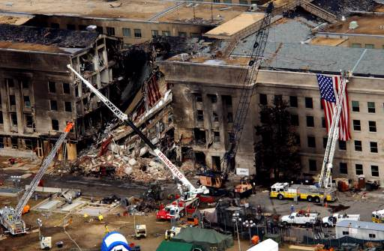
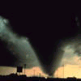
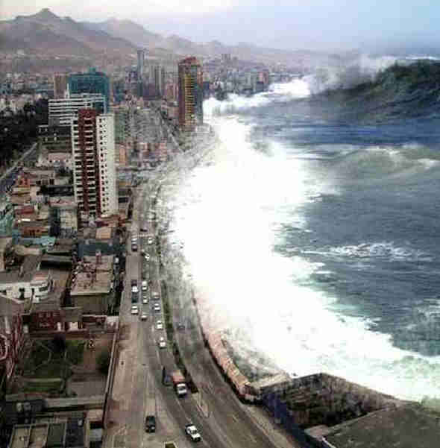
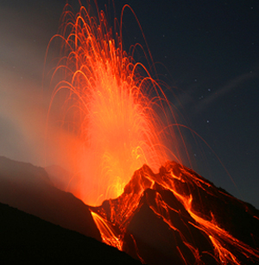
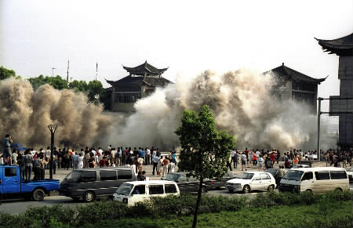

Slide 7
DEGG’S MODEL 1992
Hazardous Geophysical event e.g. Earthquake
Pop’n Vulnerable to human or economic loss
DISASTER

Slide 8
MASS DISASTER
OPEN ENDED
HUMAN MADE
NATURAL
CLOSE ENDED
Hydro-meteorological
Geophysical

Slide 9
Hydro-Meteorological
Floods | Mud flows
Hurricanes | Tropical Cyclones
Thunderstorms | Rain
Wind storms | Tornadoes
Blizzards | Drought
Bushfires | Temperature extremes
Sand Storms | Dust Storms
Caused by running water and its processes and weather patterns

Slide 10
Geophysical
Caused By Earth’s processes:
Two types:
Internal processes
:Tectonic
External processes
: Geomorphological
Volcanic Activity | Mass Movement
Earthquakes | Tsunamis
Landslides | Rock falls
Rockslides

Slide 11
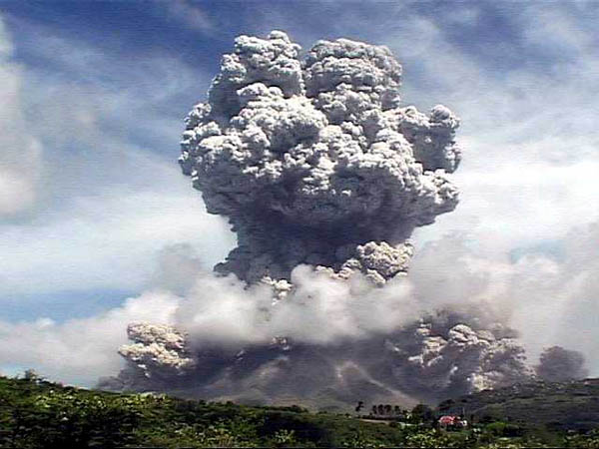
DISASTER
MANAGEMENT

Slide 12
ROLE OF DENTISTS
Dentists could supply reinforcement related to their background :
Training
Manual Dexterity
Experience in management of various
conditions as--

Slide 13
• Shock
• Debridement
• Suturing
• Reduction and immobilisation of fractures
• Control of pain
• Control of infection

Slide 14
Additional functions - dentists
• First Aid
• Early management of chest wounds
• Preparation of casualties for movement
• Assistance in general surgical procedures

Slide 15
THE TEAM OF DENTISTS
The Dental Team consists of a –-
** GO TEAM and a
** SUPPORT TEAM

Slide 16
GO TEAM—
Is a small group of dentists with experience.
Forensic Odontology and Mass Casualty Management.

Slide 17
They can be rapidly deployed to assess the situation
assist local agencies in the initial response to the disaster incident.
THE NICE THING ABOUT TEAMWORK IS THAT U ALWAYS HAVE SOMEONE BY UR SIDE

Slide 18
The "Go Team" is comprised of :
A Team Leader;
An Assistant Team Leader(s);
Section Leader(s)

Slide 19
They deal with post mortem (after death), ante mortem (before death)
And computer management analysis (comparing ante & post mortem records).
The individual "Go Team" member when deployed is committed to the incident for its entirety or at least 14 days.

Slide 20
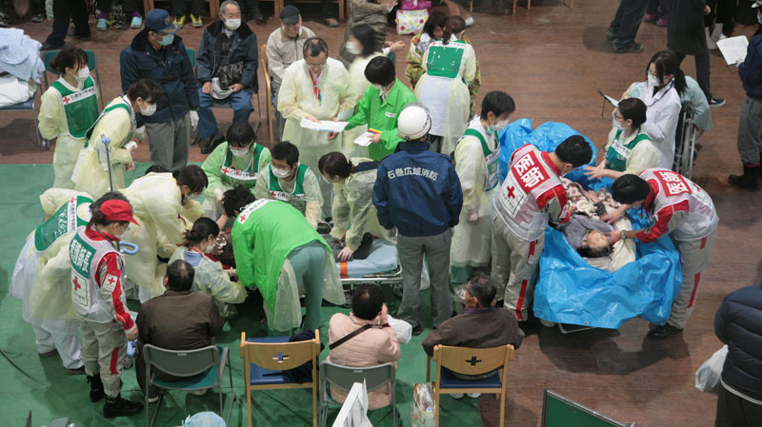
The "Support Team" consists of :
A group of dentists, hygienists and/or dental assistants who may or may not have had previous experience

Slide 21
The Support Team members will be assigned to a specific section like
post mortem, ante mortem and/or computers by the appropriate Team Leader.

Slide 22
IDENTIFICATION OF VICTIMS
The Identification of large no. of casualties in mass disasters are
Dental identification can be so accurate.

Slide 23
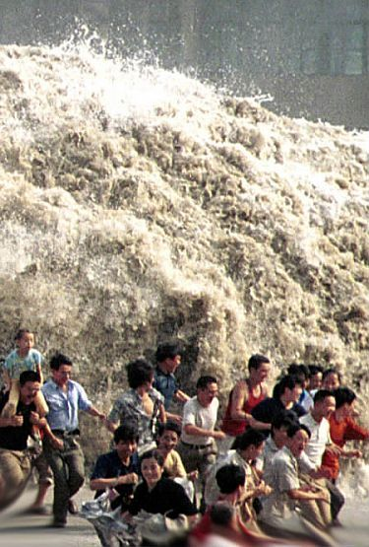
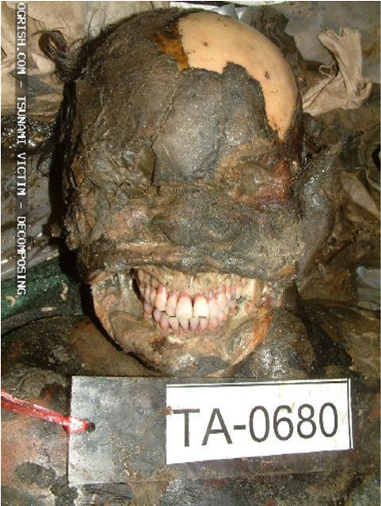
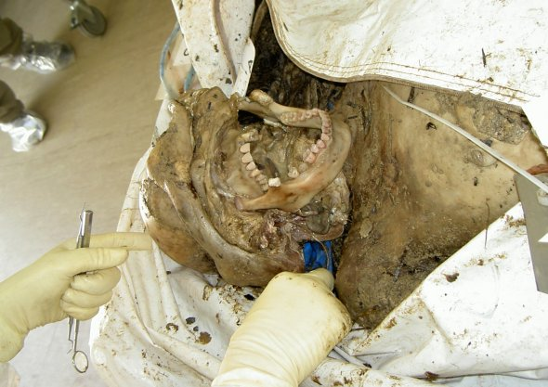
Tsunami
In Thailand
61% people were identified
using dental records
19% using finger prints
1.3% using DNA
0.3% from there personal effects

Slide 24
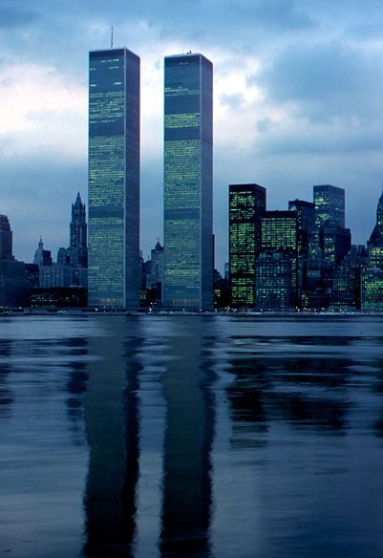
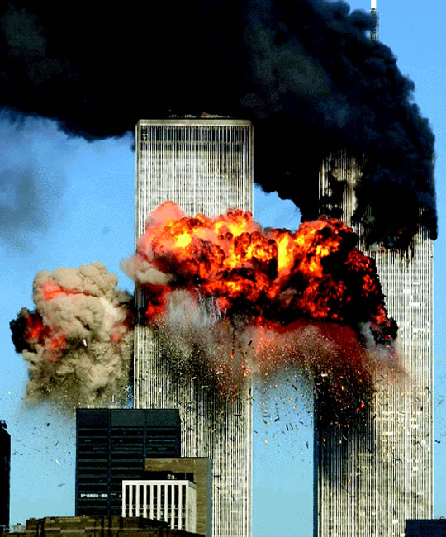
WTC Attack
Of the total death certificate issued
645 people were identified using DNA
188 using dental records
71 using finger prints
19 from their personal effects
16 by photographs

Slide 25
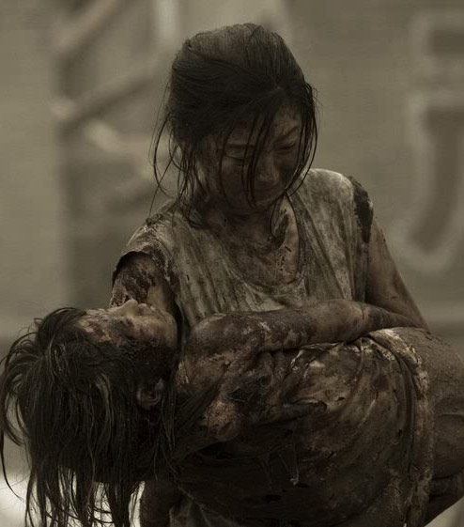
IDENTIFICATION
It consists of four main steps:
Body tagging and bagging
Finger printing
Forensic pathology
Forensic dentistry.

Slide 26
SUMMARY
Forensic dentistry plays a major role in body identification
Worldwide agencies in the field of mass disaster
INDIA is lacking in this field
Need to implement various strategies regarding forensic dentistry

Slide 27
EXPECTED QUESTIONS
Describe the role of dentist in mass disaster (saq)
What are the various methods for disaster identification ( SAQ)

Slide 28
Bibliography
Textbook of Essentials of Preventive & Community Dentistry, by Soben Peter, 3rd Edition. Arya Publishers.
Community Dentistry, by Vimal Sikri,Poonam Sikri, 1st Edition,CBS Publishers.
Text book of Preventive & Social Medicine, by Gupta & Mahajan, 3rd Edition,Japee Publishers .
PARK’S Textbook of Prfeventive and Social Medicine ,by K. Park,17th Edition,Banarasidas Bhanot Publishers.
Textbook of Preventive and Community Dentistry,1st Edition, by S.S. Hiremath,Elsevier Publications.

Slide 29
THANK YOU

